Slide 1
Project Reporting RedConnect
Members:
Tran Nguyen Bao
Le Chi Cong
Nguyen Huu Nhat Tan
Hoang Anh Hien Thao
Phan Van Vo

Slide 2

CONTENT
THEME
TOOLS AND FOUNDATION
SYSTEM DESIGN
APPRECIATION, MAINTENANCE AND IMPROVEMENT
CONCLUSION
REFERENCES

Slide 3
I. Theme: RedConnect
Realizing that the development of the social network is affecting the work concentration of the employees day by day. Therefore, a program managing employee information and helping them with exchanging information about project or group task is in need. That’s why our team decides to implement this project.

Slide 4





II. Tools and foundation
1. Tools
Frontend:
Implement based on HTML5, CSS, Javascript.
Bootstrap 4
Backend:
MariaDB : database managing system.
Java : common programming language
and easy to use.
Spring framework

Slide 5




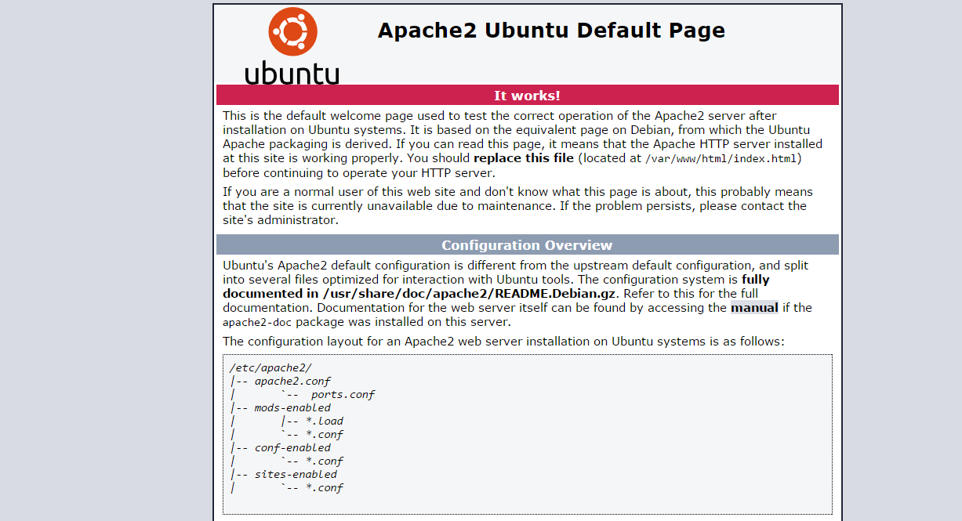


II. Tools and foundation
2. Foundation
Microsoft windows 10 professional 64bit
Elipse, spring tool 4
Oracle VM VirtualBox
Ubuntu Server 18.04
Apache tomcat 9.0.22
Apache2

Slide 6





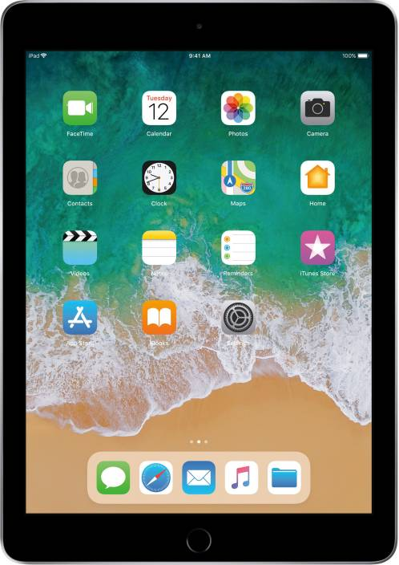
3. Server configuration
<user>
UBUNTU SERVER
INTERNET
<user>
mod_jk
AJP
connection
Tomcat1 server
Tomcat2 server
<<worker>>
Configuration file:
jk.conf
Worker.properties
Static content
<user>

Slide 7
III. System design

Slide 8
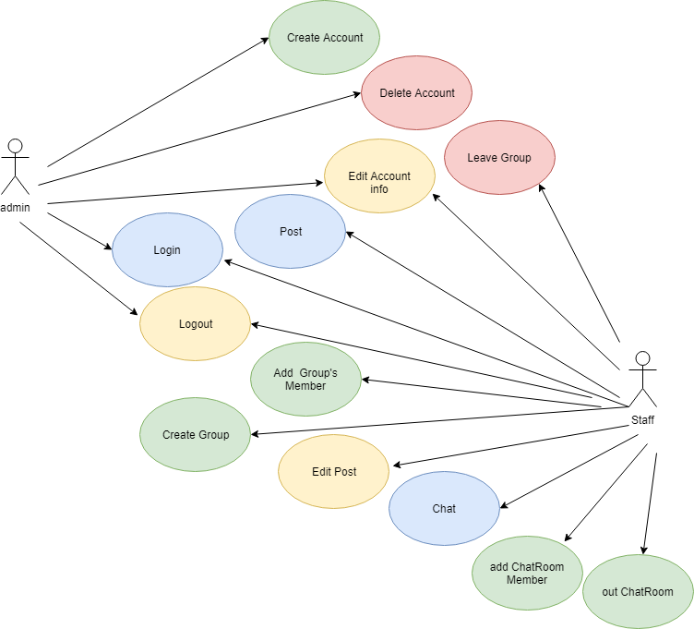
1. UseCase Diagram

Slide 9
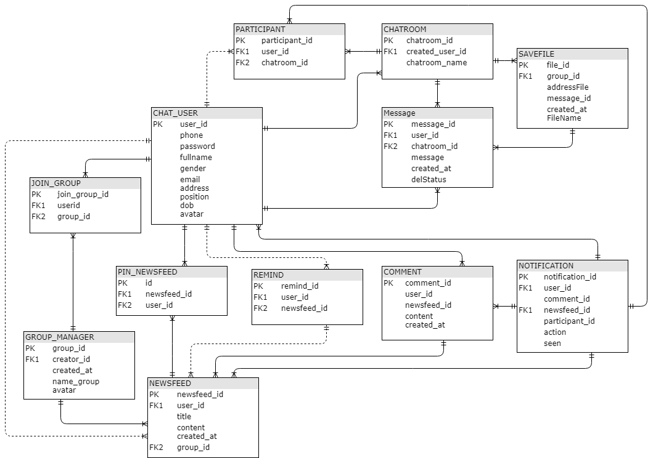


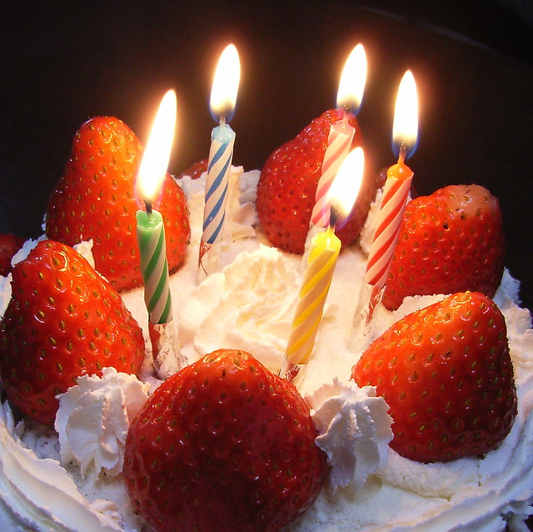


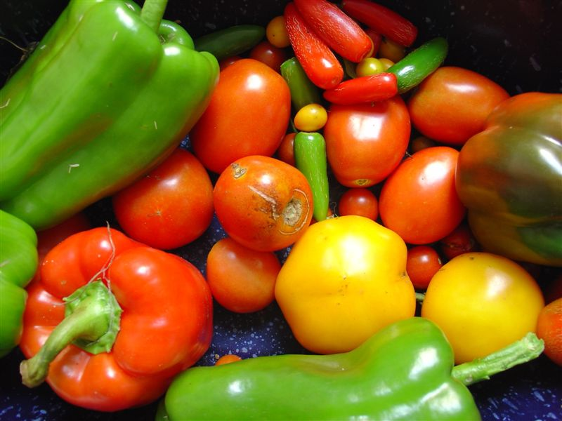

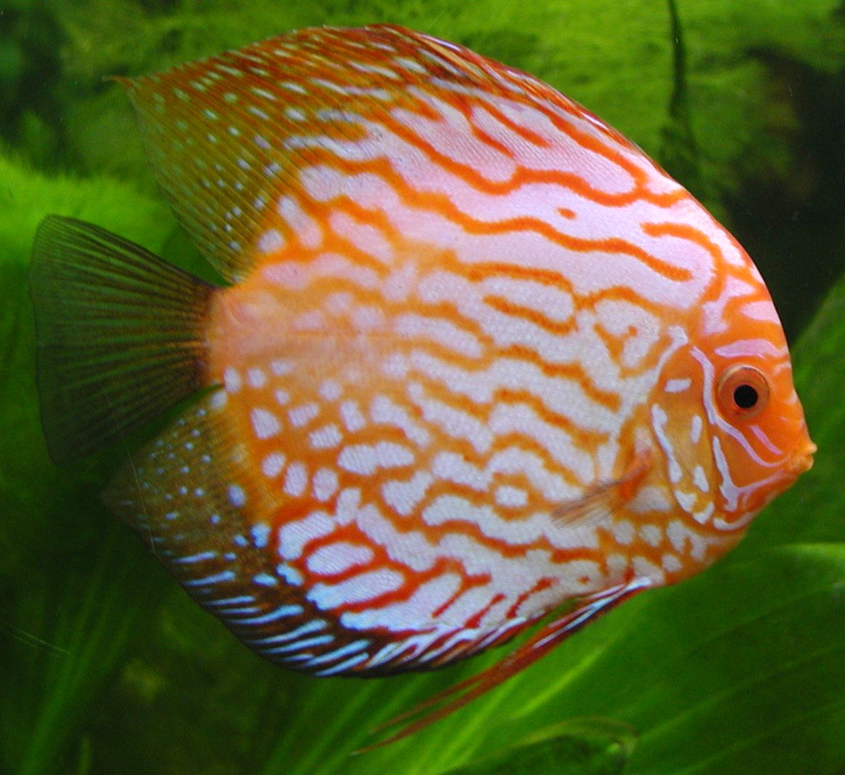
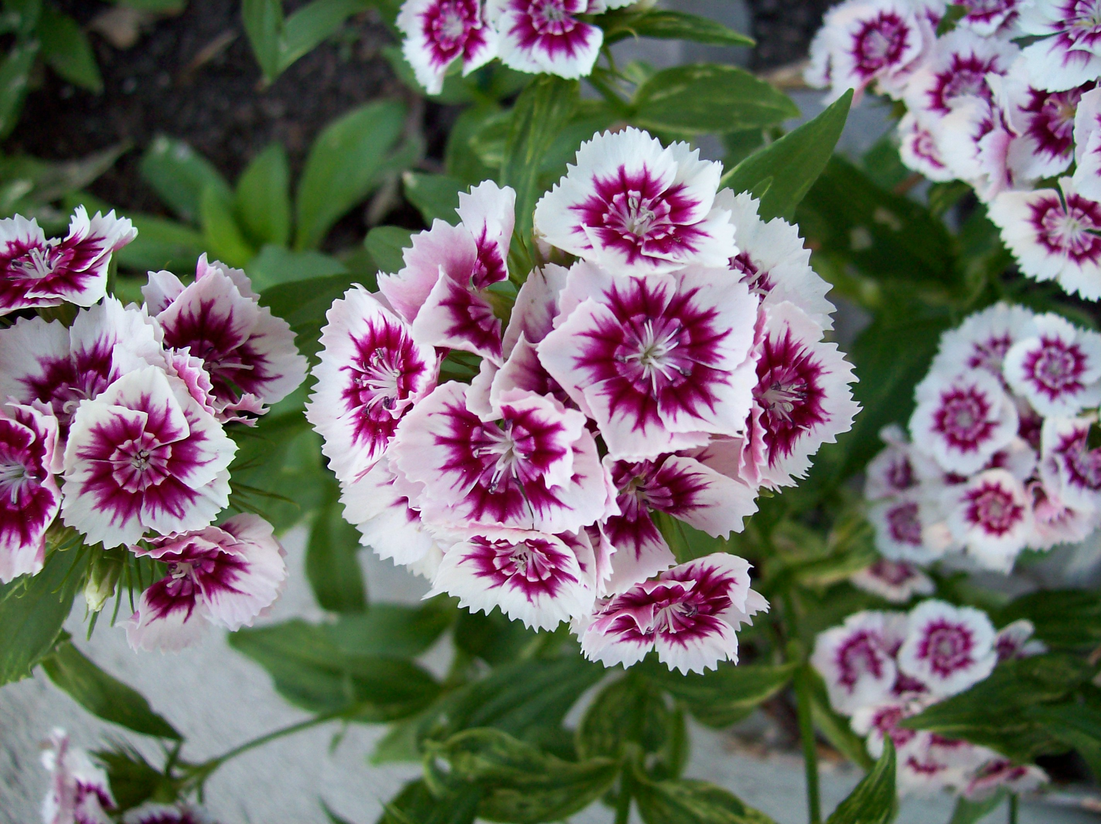



2. ERD Diagram

Slide 10
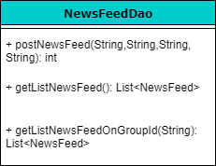
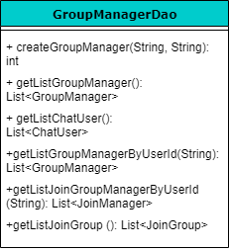
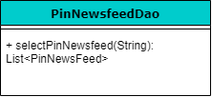
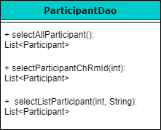
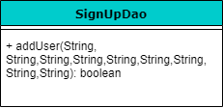
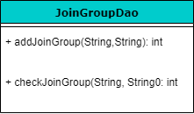
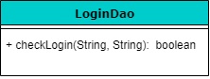
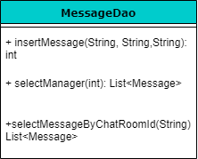
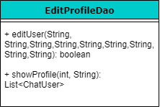
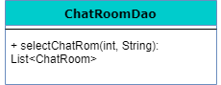
III. System design
3. Design phases

Slide 11
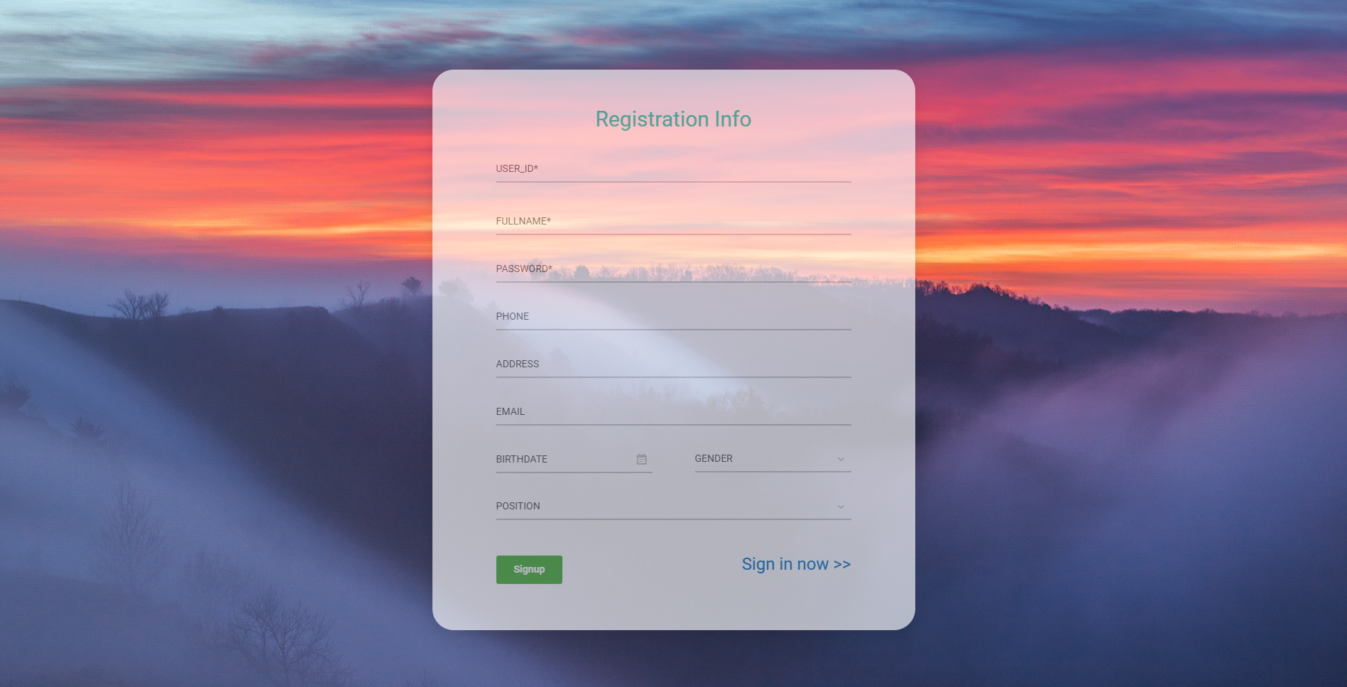
III. System design
4. Sample layout
Signup

Slide 12
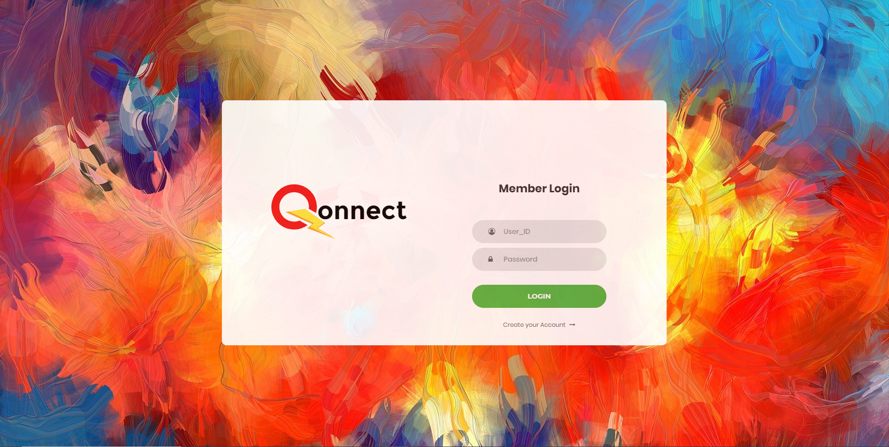
III. System design
4. Sample layout
Login

Slide 13
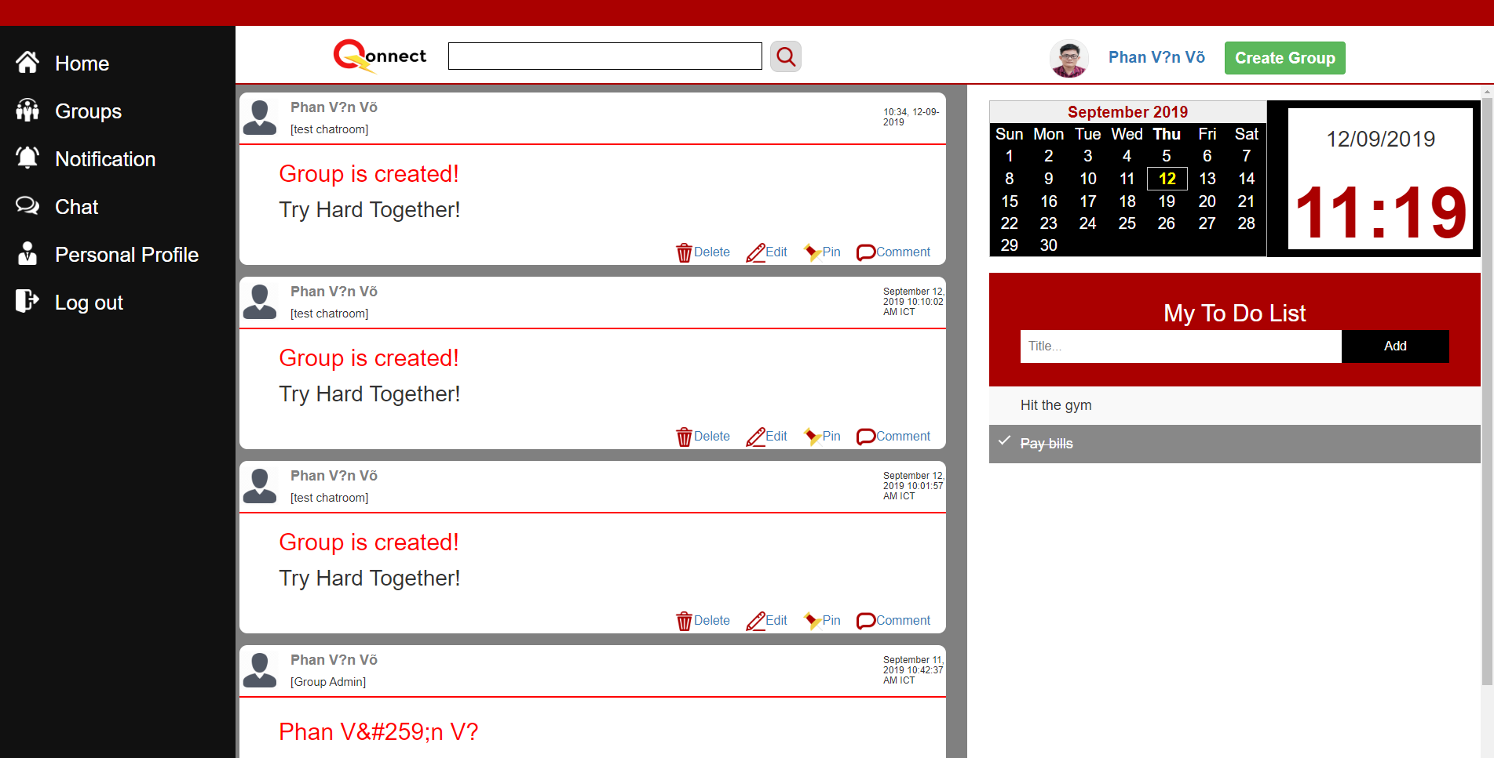
III. System design
4. Sample layout
Homepage UI
From Home, we able
to reach:
Groups
Notification
Chat
Personal Profile
Log out
At Homepage, we can
Create Group

Slide 14
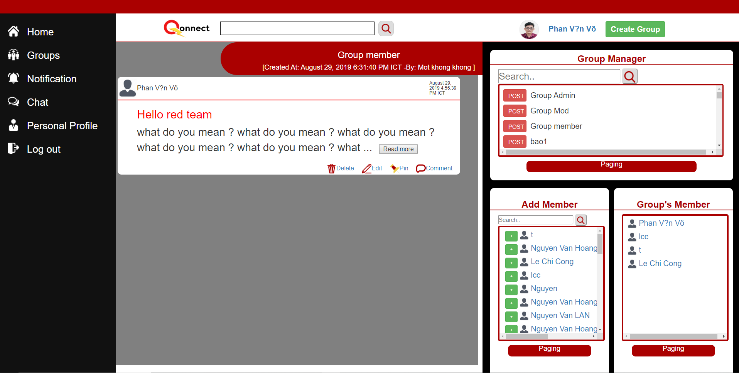
III. System design
4. Sample layout
Group home
Group Manager
Post
Show Group name
Add Member
Friend list
Group’s Member
Choosing user button to add user to Group’s Member

Slide 15
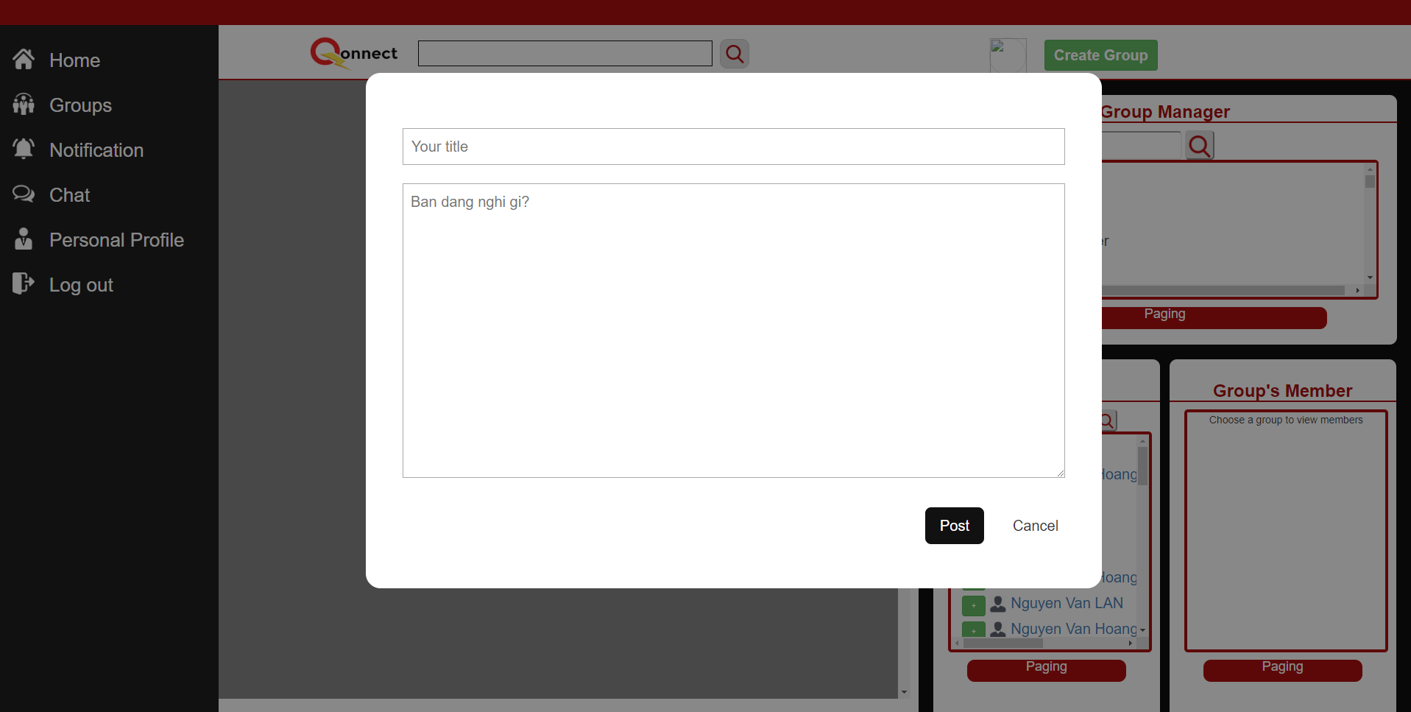
III. System design
4. Sample layout
Group home
Group Manager
Post
Show Group name

Slide 16
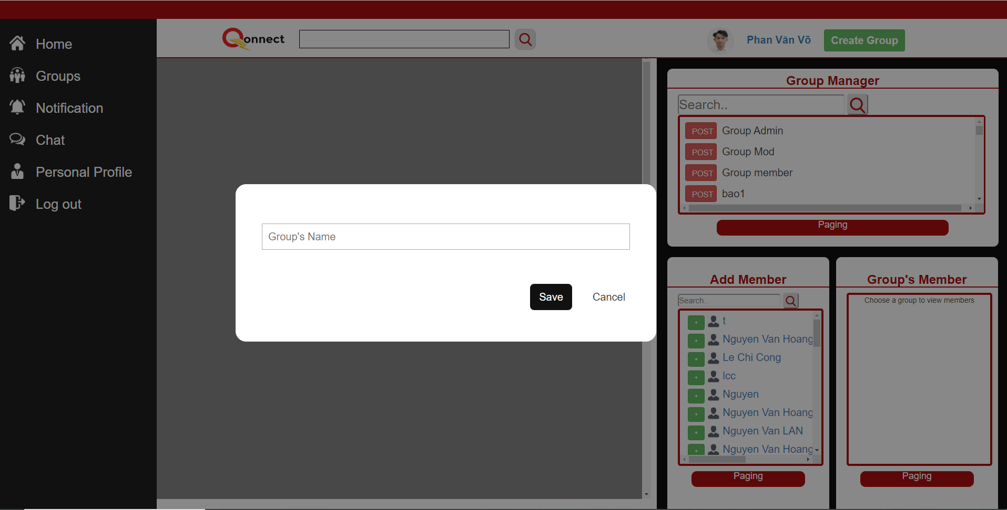
III. System design
4. Sample layout
Create Group

Slide 17
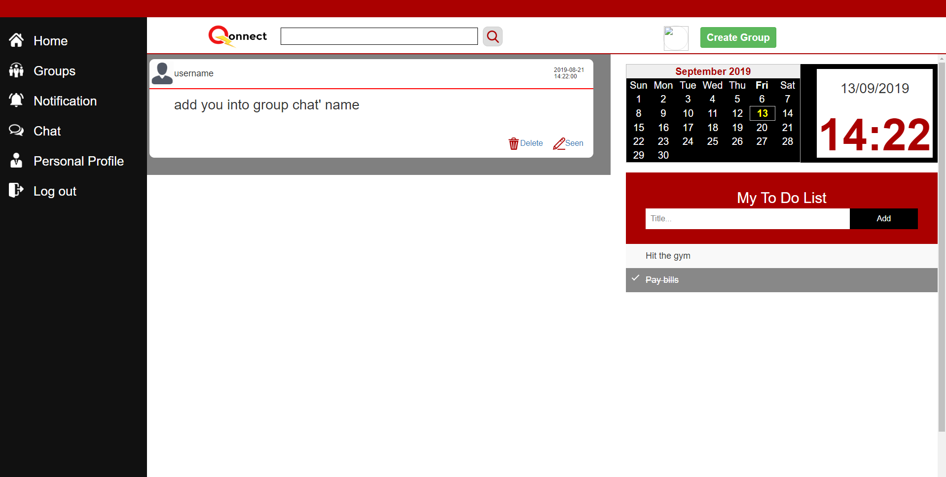
III. System design
4. Sample layout
Notification

Slide 18
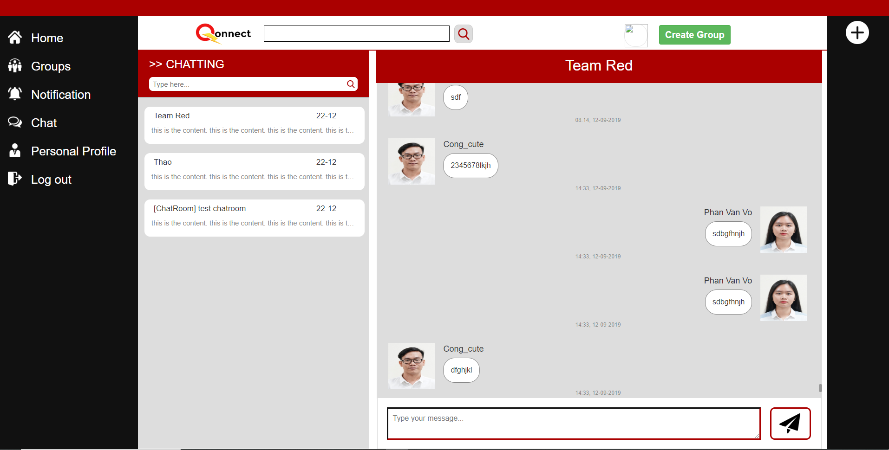
III. System design
4. Sample layout
Chat

Slide 19
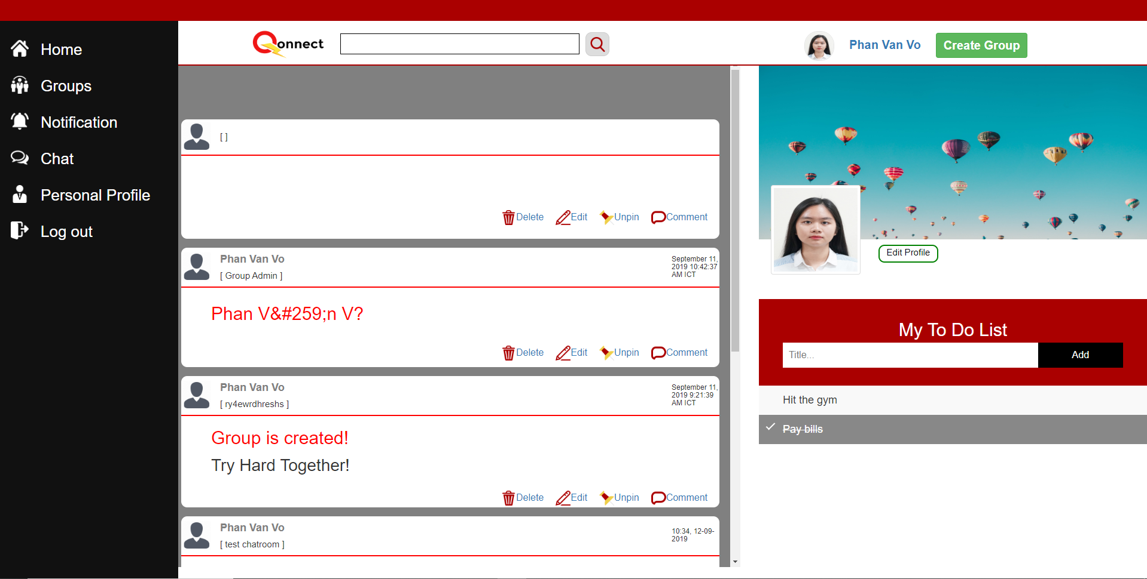
III. System design
4. Sample layout
Edit profile

Slide 20
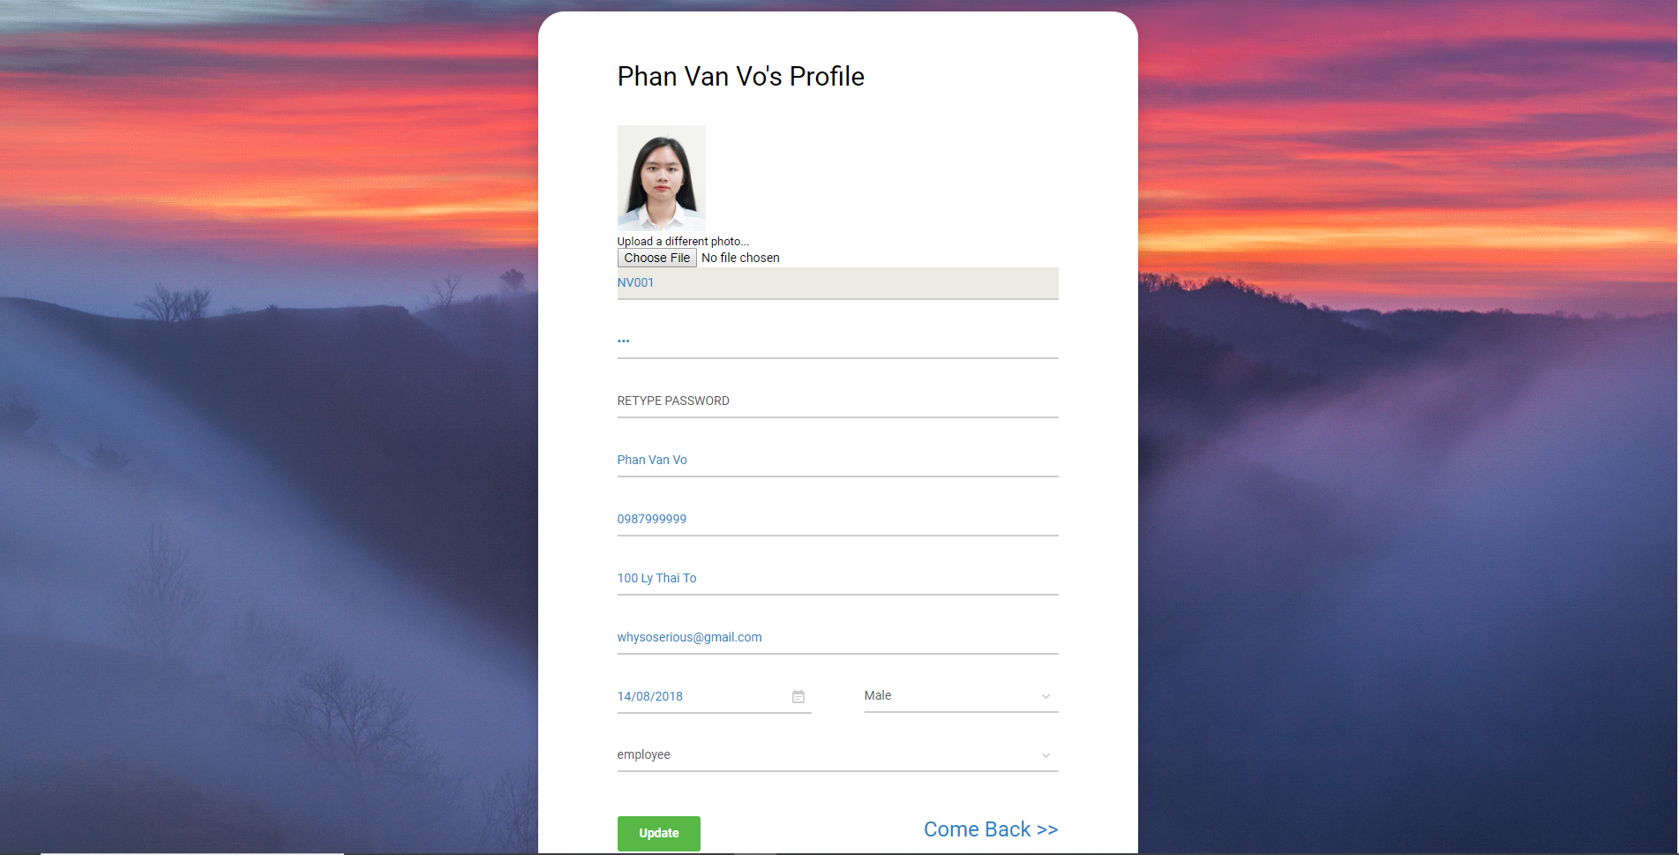
III. System design
4. Sample layout
Edit profile

Slide 21
IV. Appreciation, maintenance and improvement
Good!
1. Appreciation

Slide 22
IV. Appreciation, maintenance and improvement
NO
2. Maintenance

Slide 23
IV. Appreciation, maintenance and improvement
TO BE CONTINUE …
3. Improvement

Slide 24
V. Conclusion
TO BE CONTINUE …

Slide 25
VI. References
https://mvnrepository.com
https://bootsnipp.com
https://www.w3schools.com

Slide 26


